Slide 1
Class Relationship
CSG2H3 Object Oriented Programming

Slide 2
CSG2H3 Object Oriented Programming
Array in Java

Slide 3
Array
the second kind of reference types in Java
an ordered collection, or numbered list, of values.
The values can be primitive values, objects, or even other arrays, but all of the values in an array must be of the same type.

Slide 4
Declaring Array
byte b; // byte is a primitive type
byte[] arrayOfBytes; // byte[] is an array type: array of byte
byte[][] arrayOfArrayOfBytes; // byte[][] is another type: array of byte[]
Point[] points; // Point[] is an array of Point objects

Slide 5
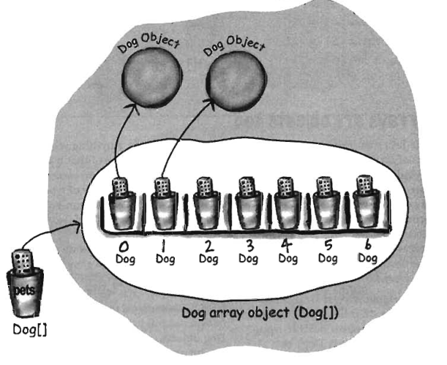
Array
Dog[] pets;
pets = new Dog[7];
pets[0] = new Dog()
pets[1] = new Dog()

Slide 6
Compatibility with C and C++
byte arrayOfBytes[]; // Same as byte[] arrayOfBytes
byte arrayOfArrayOfBytes[][]; // Same as byte[][] arrayOfArrayOfBytes
byte[] arrayOfArrayOfBytes[]; // Same as byte[][] arrayOfArrayOfBytes
This is almost always a confusing syntax, however, and it is not recommended.

Slide 7
Creating Array
Use the new keyword, just as you do to create an object, however arrays don't need to be initialized like objects do
Must specify the length, once created the array size cannot be changed
byte[] buffer = new byte[1024];
String[] lines = new String[50];

Slide 8
Array Literals
The null literal used to represent the absence of an object can also be used to represent the absence of an array.
char[] password = null;
combines the creation of the array object with the initialization of the array elements:
int[] powersOfTwo = {1, 2, 4, 8, 16, 32, 64, 128};

Slide 9
Multidimensional Array
int[][] products;
Each of the pairs of square brackets represents one dimension, so this is a two-dimensional array.
To access a single int element of this two-dimensional array, you must specify two index values, one for each dimension.
To create a new multidimensional array, use the new keyword and specify the size of both dimensions of the array.
int[][] products = new int[10][10];

Slide 10
Multidimensional Array
The new keyword performs this additional initialization automatically for you. It works with arrays with more than two dimensions as well:
float[][][] globalTemperatureData = new float[360][180][100];

Slide 11
Multidimensional Array
When using new with multidimensional arrays, you do not have to specify a size for all dimensions of the array, only the leftmost dimension or dimensions.
float[][][] globalTemperatureData = new float[360][][];
float[][][] globalTemperatureData = new float[360][180][];

Slide 12
Multidimensional Array
The first line creates a single-dimensional array, where each element of the array can hold a float[][].
The second line creates a two-dimensional array, where each element of the array is a float[].
If you specify a size for only some of the dimensions of an array, however, those dimensions must be the leftmost ones. The following lines are not legal:
float[][][] globalTemperatureData = new float[360][][100]; // Error!
float[][][] globalTemperatureData = new float[][180][100]; // Error!

Slide 13
CSG2H3 Object Oriented Programming
Class Diagram

Slide 14
Unified Modeling Language
Unified Modeling Language (UML) is a standardized general-purpose modeling language in the field of software engineering. The standard is managed, and was created by, the Object Management Group.
UML includes a set of graphic notation techniques to create visual models of software-intensive systems.

Slide 15
What is UML and Why we use UML?
UML → “Unified Modeling Language”
Language: express idea, not a methodology
Modeling: Describing a software system at a high level of abstraction
Unified: UML has become a world standard
Object Management Group (OMG): www.omg.org

Slide 16
Classes
A class is a description of a set of
objects that share the same attributes,
operations, relationships, and semantics.
Graphically, a class is rendered as a
rectangle, usually including its name,
attributes, and operations in separate,
designated compartments.
ClassName
attributes
operations
Class Name
Window
size: Size visibility: boolean
Attributes
display() hide()
Operations

Slide 17
Class Names
ClassName
The name of the class is the only required tag in the graphical representation of a class. It always appears in the top-most compartment.
attributes
operations

Slide 18
Class Attributes
Person
name : String
address : Address
birthdate : Date
ssn : Id
An attribute is a named property of a
class that describes the object being modeled.
In the class diagram, attributes appear in
the second compartment just below the
name-compartment.

Slide 19
Class Attributes
Attributes are usually listed in the form:
attributeName : Type
A derived attribute is one that can be
computed from other attributes, but
doesn’t actually exist. For example,
a Person’s age can be computed from
his birth date. A derived attribute is
designated by a preceding ‘/’ as in:
/ age : Date
Person
name : String
address : Address
birthdate : Date
/ age : Date
ssn : Id

Slide 20
Class Attributes
Person
+ name : String
# address : String
- birthdate : Date
age : integer
- idNumber : integer
Attributes can be:
+ public
# protected
- private
Normally use private for field

Slide 21
Class Operations
Person
name : String
address : String
birthdate : Date
age : integer
idNumber : integer
eat
sleep
work
play
Operations describe the class behavior
and appear in the third compartment.

Slide 22
Class Operations
PhoneBook
newEntry (n : Name, a : Address, p : PhoneNumber, d : Description)
getPhone ( n : Name, a : Address) : PhoneNumber
You can specify an operation by stating its signature: listing the name, type, and default value of all parameters, and, in the case of functions, a return type.

Slide 23
Example
public class Person{
private String name;
private String address;
private Date birthdate;
private int idNumber;
public void eat(String food){
System.out.println("i eat "+food);
}
public void setName(String name){
this.name = name;
}
public String getName(){
return name;
}
}

Slide 24
Depicting Classes
When drawing a class, you needn’t show attributes and operation in every diagram.
Person
Person
Person
name : String
birthdate : Date
ssn : Id
Person
name
address
birthdate
eat()
sleep()
work()
play()
Person
eat
play

Slide 25
CSG2H3 Object Oriented Programming
Class Relationship

Slide 26
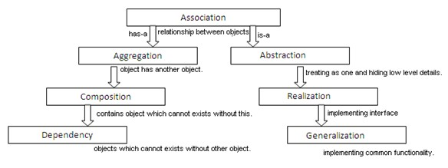
Class Association

Slide 27
Association Relationships
If two classes in a model need to communicate with each other, there must be link between them.
An association denotes that link.
An association between two classes indicates that objects at one end of an association “recognize” objects at the other end and may send messages to them.
Student
Instructor

Slide 28
Example
public class Student{
private String name;
private String assignment;
public Student(String name){
this.name = name;
}
public void setName(String name){
this.name = name;
}
public String getName(){
return name;
}
public void setAssignment(String assignment){
this.assignment = assignment;
}
public String getAssignment(){
return assignment;
}
}

Slide 29
Example
public class Instructor{
private String name;
public Instructor(String name){
this.name = name;
}
public void giveAssignment(Student s, String assignment){
s.setAssignment(assignment);
}
}
public class Driver{
public static void main(String args[]){
Student s1 = new Student("andi");
Instructor i1 = new Instructor("budi");
i1.giveAssignment(s1,"code java OOP");
System.out.println(s1.getAssignment());
}
}

Slide 30
Association Relationships
We can indicate the multiplicity of an association by adding multiplicity adornments to the line denoting the association.
The example indicates that a Student has one or more Instructors:
Student
Instructor
1..*

Slide 31
Association Relationships
The example indicates that every Instructor has one or more Students:
Student
Instructor
1..*

Slide 32
Association Relationships
We can also indicate the behavior of an object in an association (i.e., the role of an object) using rolenames.
teaches
learns from
Student
Instructor
1..*
1..*

Slide 33
Association Relationships
We can also name the association.
membership
Student
Team
1..*
1..*

Slide 34
Association Relationships
We can specify dual associations.
member of
Student
Team
1..*
1..*
1
president of
1..*

Slide 35
Association Relationships
We can constrain the association relationship by defining the navigability of the association. Here, a Router object requests services from a DNS object by sending messages to (invoking the operations of) the server. The direction of the association indicates that the server has no knowledge of the Router.
Router
DomainNameServer

Slide 36
Association Relationships
Associations can also be objects themselves, called link classes or an association classes.
Registration
modelNumber
serialNumber
warrentyCode
Product
Warranty

Slide 37
Association Relationships
A class can have a self association.
next
LinkedListNode
previous

Slide 38
Aggregation Relationships
We can model objects that contain other objects by way of special associations called aggregations and compositions.
An aggregation specifies a whole-part relationship between an aggregate (a whole) and a constituent part, where the part can exist independently from the aggregate. Aggregation is a variant of the "has a" or association relationship.
Aggregations are denoted by a hollow-diamond adornment on the association.
Car
Engine
Transmission

Slide 39
Example
public class Engine {
private String name;
private int horsePower;
public Engine(String name){
this.name = name;
}
public int getHorsePower() {
return horsePower;
}
public void setHorsePower(int hp) {
this.horsePower = hp;
}
}
public class Transmission {
private String type;
public String getType() {
return type;
}
public void setType(String type) {
this.type = type;
}
}

Slide 40
Example
public class Car {
private String name;
private Engine engine;
private Transmission transmission;
public Car(String name){
this.name = name;
}
public void addEngine(Engine e){
engine = e;
}
public void addTransmission(Transmission t){
transmission = t;
}
}

Slide 41
Example
public class Driver {
public static void main(String[] args) {
Car c = new Car("honda");
Engine v1000 = new Engine("v1000");
Transmisson auto = new Transmisson();
auto.setType("Automatic");
c.addEngine(v1000);
c.addTransmission(auto);
}
}

Slide 42
Composition Relationships
Composition is a stronger variant of the "owns a" or association relationship
A composition indicates a strong ownership and coincident lifetime of parts by the whole (i.e., they live and die as a whole). Compositions are denoted by a filled-diamond adornment on the association.
Window
Scrollbar
1
1
Titlebar
1
1
Menu
1
1 .. *

Slide 43
Example
public class Scrollbar {
public String type;
public Scrollbar(String type){
this.type = type;
}
}
public class Titlebar {
public String title;
public Titlebar(String title){
this.title = title;
}
}

Slide 44
Example
public class Menu {
private String title;
private String type;
public Menu(String title, String type){
this.title = title;
this.type = type;
}
}

Slide 45
Example
public class Window {
private Scrollbar scBar;
private Titlebar tlBar;
private Menu[] menu;
public Window(String title, String scrollType, int numMenu){
scBar = new Scrollbar(scrollType);
tlBar = new Titlebar(title);
menu = new Menu[numMenu];
}
}
public class Driver {
public static void main(String[] args) {
Window w = new Window("OOP Window", "vertical", 5);
}
}

Slide 46
Interfaces
An interface is a named set of operations that specifies the behavior of objects without showing their inner structure. It can be rendered in the model by a one- or two-compartment rectangle, with the stereotype <<interface>> above the interface name.
<<interface>>
ControlPanel

Slide 47
Example Specify the appropriate relation to each case:
A person and a car that he wants to buy
A car in a parking lot
A mall and its parking lot
Wheels in a car
A department and a company
A department and an employee
A canteen and a department
A pond and fishes

Slide 48
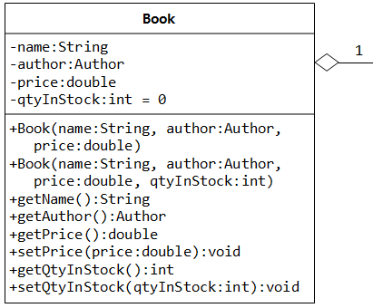
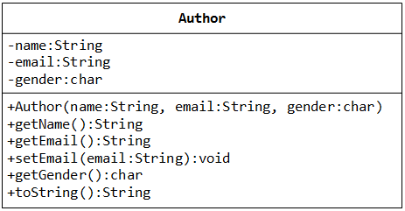
Exercise

